Slide 1


Computational Fluid Dynamics II H-Grid and C-Grid Grid Generation
Muhammad Nauval Hamzah – 23620024
Mohammad Zaini Ma’ruf - 23620015

Slide 2
START
A
B
Nodal Configuration
jMax, nairfoil, ngap, nflap, nAirfoilWake, nOutflow
Initialize Boundary Coordinates
Boundary Configuration
chord
thickness
Boundary Normalization
nwake = nAirfoilWake + nOutflow - 1
imax = 2*nAirfoil + 2*nWake + 2*nflap + 2*nwake - 7
gap = 0.1*chord
flap = 0.2*chord
rOutflow = 10*chord
rFarfield = 5*chord
wakeChord = 0.2*chord
Boundary-Blended Control Function
Initialize Point Coordinates
A
B

Slide 3
C
D
Trans-finite Interpolation
Mesh Quality
meshArea
meshSkewness
Laplace Smoothing
Mesh Quality
meshArea
meshSkewness
Data Structure
Error < 0.0001
No
C
END
Yes
D

Slide 4
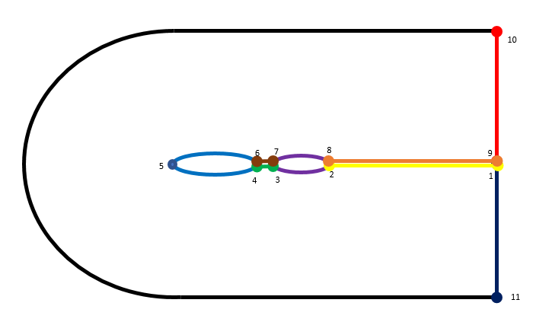
C-Grid Physical Domain
11
rOutflow
rFarfield
gap
thickness
chord
flap
12
13

Slide 5
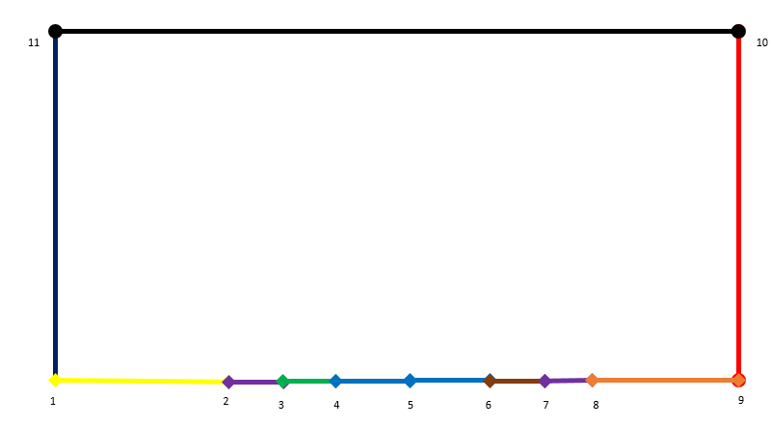
C-Grid Computational Domain
iMax
jMax
nFlap
nAirfoil
nGap
nWake

Slide 6
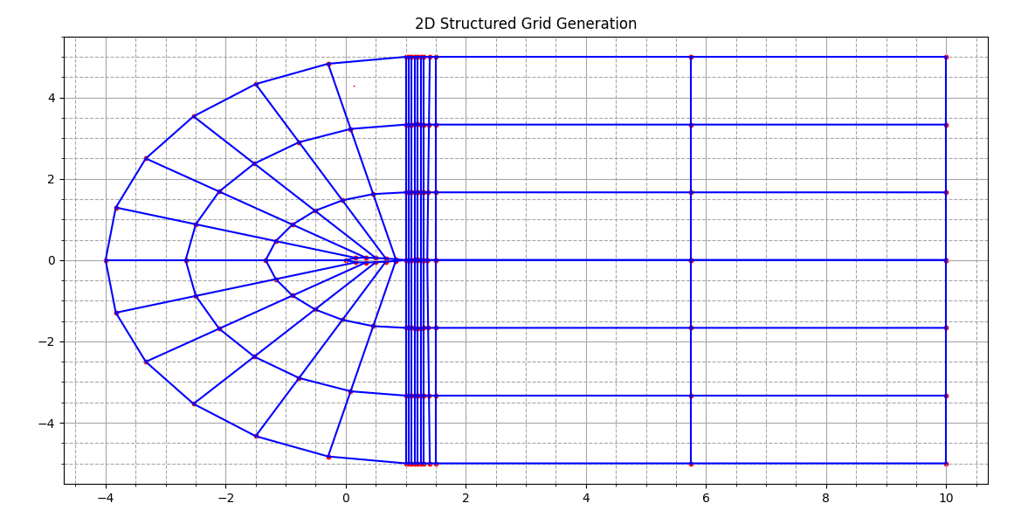
C-Grid Data Structure

Slide 7
C-Grid Data Structure : General
2033
2023 | 2024 | 2025-2028 | 2029 | 2030 | 2031 | 2032
122
123
124
128
129
130
131
132
89 | 90 | 91-94 | 95 | 96 | 97 | 98
3003
3002
3001
3004
56 | 57 | 58-61 | 62 | 63 | 64 | 65
99
3003
23 | 24 | 25-28 | 29 | 30 | 31 | 32
66
3002
2022-2011
88-77
55-44
22-11
23
24
25
29
30
31
32
33
3001
11
10
9
5
4
3
2
1
10 | 9 | 8-5 | 4 | 3 | 2 | 1
1001
1002
1003
1001
43 | 42 | 41-38 | 37 | 36 | 35 | 34
34
1002
76 | 75 | 74-71 | 70 | 69 | 68 | 67
67
1003
109
104
100
1004
110
108
103
102
101
2010 | 2009 | 2008-2005 | 2004 | 2003 | 2002 | 2001
2001

Slide 8
C-Grid Data Structure : Airfoil and Flap
17 | 18 | 19 | 20 | 21 | 22
25 | 26 | 27 | 28
17
18
19
23
25
29
4011 | 4012 | 4013 | 4014 | 4015 | 4016
4017 | 4018 | 4019 | 4020
4012
4013
4018
4019
4023
4011
4010
4009
4008
4007
4006
4005
4001
4010 | 4009 | 4008 | 4007 | 4006 | 4005
4004 | 4003 | 4002 | 4001
17
16
15
14
13
12
11
9
8
7
6
5
16 | 15 | 14 | 13 | 12 | 11
8 | 7 | 6 | 5

Slide 9
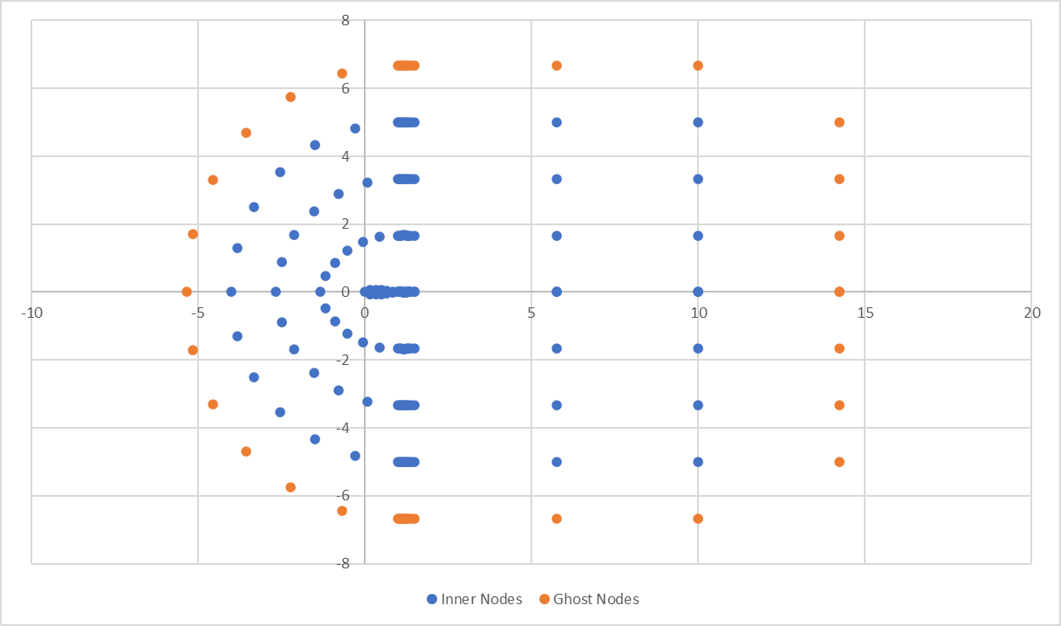
C-Grid Data Structure : Nodes Coordinates

Slide 10
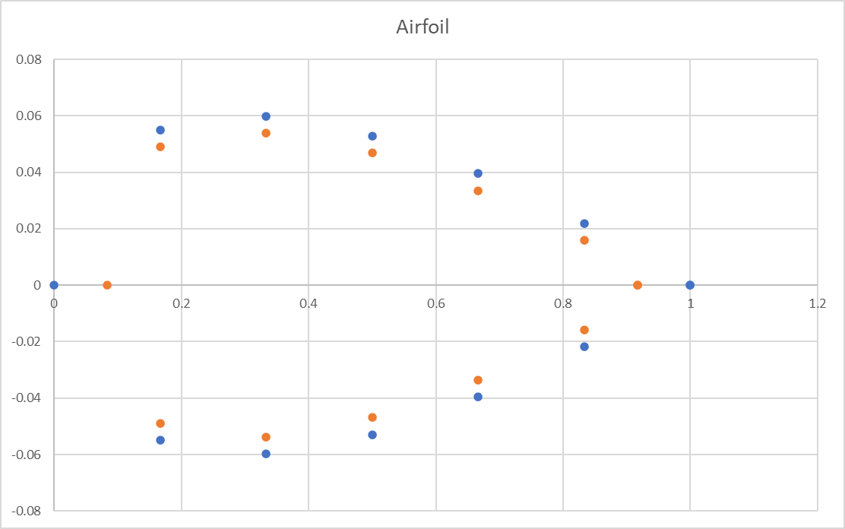
C-Grid Data Structure : Nodes Coordinates

Slide 11
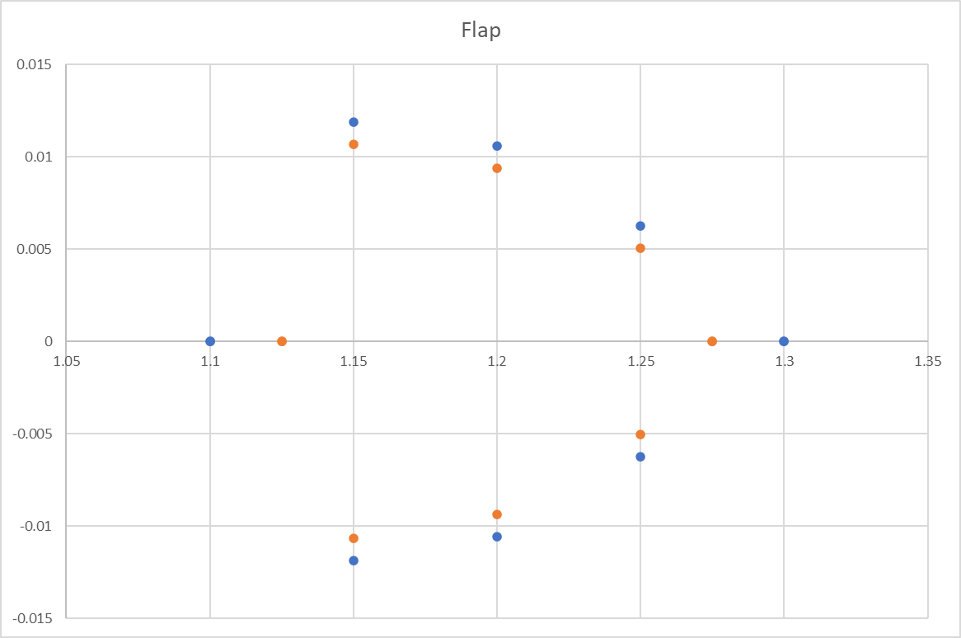
C-Grid Data Structure : Nodes Coordinates

Slide 12
H-Grid Physical Domain
N’
M’
L’
K’
J’
I’
H’
dFarfield
chord
dFlap
dInlet
dGap
dWake
dOutflow
A
B
C
D
E
F
G
N
M
L
K
J
I
H

Slide 13
H-Grid Computational Domain
iMax
N’
M’
L’
K’
J’
I’
H’
nInlet
nAirfoil
nGap
nFlap
nWake
nOutflow
jMax
A
B
C
D
E
F
G
N
M
L
K
J
I
H

Slide 14
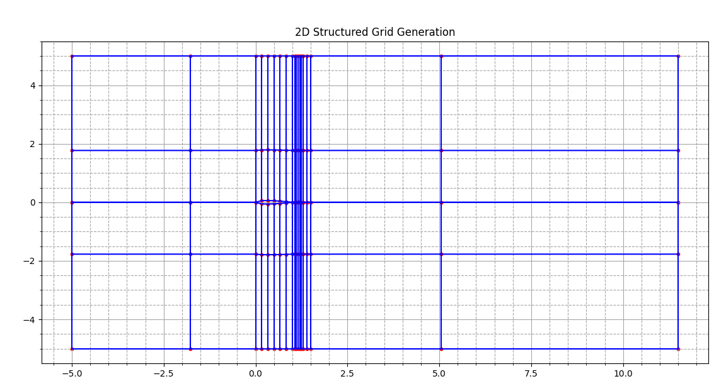
H-Grid Data Structure

Slide 15
H-Grid Data Structure : General
 |  |  |  |  |  | 3001 |  |  | 3002 |  |  | 3003 |  |  | 3009 |  |  | 3010 |  |  | 3011 |  |  | 3015 |  |  | 3016 |  |  | 3017 |  |  | 3018 |  |  | 3019
 |  |  |  |  |  |  | 3001 |  |  | 3002 |  |  | 3003-3008 |  |  | 3009 |  |  | 3010 |  |  | 3011-3014 |  |  | 3015 |  |  | 3016 |  |  | 3017 |  |  | 3018
 | 4006 |  |  |  |  | 96 |  |  | 97 |  |  | 98 |  |  | 104 |  |  | 105 |  |  | 106 |  |  | 110 |  |  | 111 |  |  | 112 |  |  | 113 |  |  |  | 114 |  |  |  |  | 2006
 |  | 4004 |  |  |  |  | 77 |  |  | 78 |  |  | 79-84 |  |  | 85 |  |  | 86 |  |  | 87-90 |  |  | 91 |  |  | 92 |  |  | 93 |  |  | 94 |  |  |  |  | 2004
 | 4005 | 4003 |  |  |  | 77 | 58 |  |  | 59 |  |  | 60-65 |  |  | 66 |  |  | 67 |  |  | 68-71 |  |  | 72 |  |  | 73 |  |  | 74 |  |  | 75 |  |  | 95 |  | 2003 |  |  | 2005
4003 | 4004 | 4002 |  |  | 39 | 58 | 20 |  |  | 21 |  |  | 22-27 |  |  | 28 |  |  | 29 |  |  | 30-33 |  |  | 34 |  |  | 35 |  |  | 36 |  |  | 37 |  |  | 57 | 76 | 2002 |  |  | 2003 | 2004
 | 4002 | 4001 |  |  |  | 20 | 1 |  |  | 2 |  |  | 3-8 |  |  | 9 |  |  | 10 |  |  | 11-14 |  |  | 15 |  |  | 16 |  |  | 17 |  |  | 18 |  |  | 38 |  | 2001 |  |  | 2002
 | 4001 |  |  |  |  | 1 |  |  | 2 |  |  | 3 |  |  | 9 |  |  | 10 |  |  | 11 |  |  | 15 |  |  | 16 |  |  | 17 |  |  | 18 |  |  | 19 |  |  |  |  |  | 2001
 |  |  |  |  |  |  | 1001 |  |  | 1002 |  |  | 1003-1008 |  |  | 1009 |  |  | 1010 |  |  | 1011-1014 |  |  | 1015 |  |  | 1016 |  |  | 1017 |  |  | 1018
 |  |  |  |  |  | 1001 |  |  | 1002 |  |  | 1003 |  |  | 1009 |  |  | 1010 |  |  | 1011 |  |  | 1015 |  |  | 1016 |  |  | 1017 |  |  | 1018 |  |  | 1019

Slide 16
H-Grid Data Structure : Airfoil and Flap
 | 60 |  |  | 61 |  |  | 62 |  |  | 63 |  |  | 64 |  |  | 65 |  |  |  |  | 68 |  |  | 69 |  |  | 70 |  |  | 71
60 |  |  | 61 |  |  | 62 |  |  | 63 |  |  | 64 |  |  | 65 |  |  | 66 |  | 68 |  |  | 69 |  |  | 70 |  |  | 71 |  |  | 72
 | 6001 |  |  | 6002 |  |  | 6003 |  |  | 6004 |  |  | 6005 |  |  | 6006 |  |  |  |  | 6007 |  |  | 6008 |  |  | 6009 |  |  | 6010
1 |  |  | 2 |  |  | 3 |  |  | 4 |  |  | 5 |  |  | 6 |  |  | 7 |  | 8 |  |  | 9 |  |  | 10 |  |  | 11 |  |  | 12
1 |  |  | 2 |  |  | 3 |  |  | 4 |  |  | 5 |  |  | 6 |  |  | 7 |  | 8 |  |  | 9 |  |  | 10 |  |  | 11 |  |  | 12
 | 5001 |  |  | 5002 |  |  | 5003 |  |  | 5004 |  |  | 5005 |  |  | 5006 |  |  |  |  | 5007 |  |  | 5008 |  |  | 5009 |  |  | 5010
41 |  |  | 42 |  |  | 43 |  |  | 44 |  |  | 45 |  |  | 46 |  |  | 47 |  | 49 |  |  | 50 |  |  | 51 |  |  | 52 |  |  | 53
 | 22 |  |  | 23 |  |  | 24 |  |  | 25 |  |  | 26 |  |  | 27 |  |  |  |  | 30 |  |  | 31 |  |  | 32 |  |  | 33
22 |  |  | 23 |  |  | 24 |  |  | 25 |  |  | 26 |  |  | 27 |  |  | 28 |  | 30 |  |  | 31 |  |  | 32 |  |  | 33 |  |  | 34

Slide 17
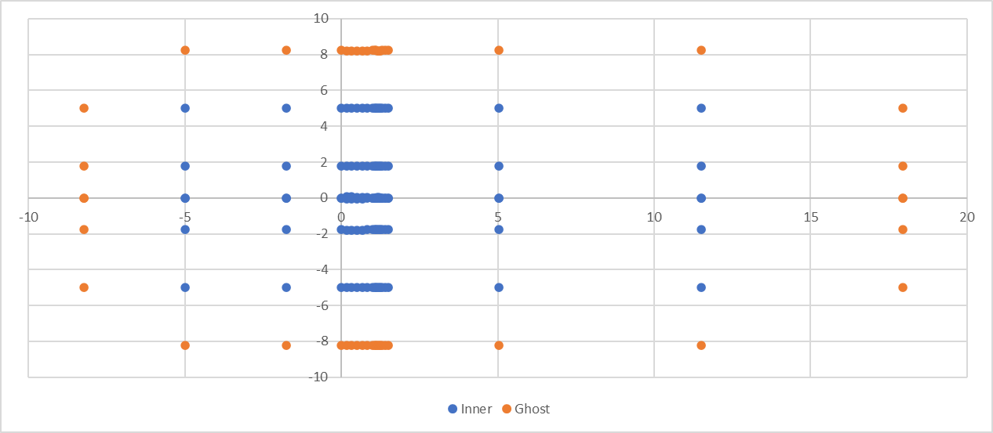
H-Grid Data Structure : Nodes Coordinates

Slide 18
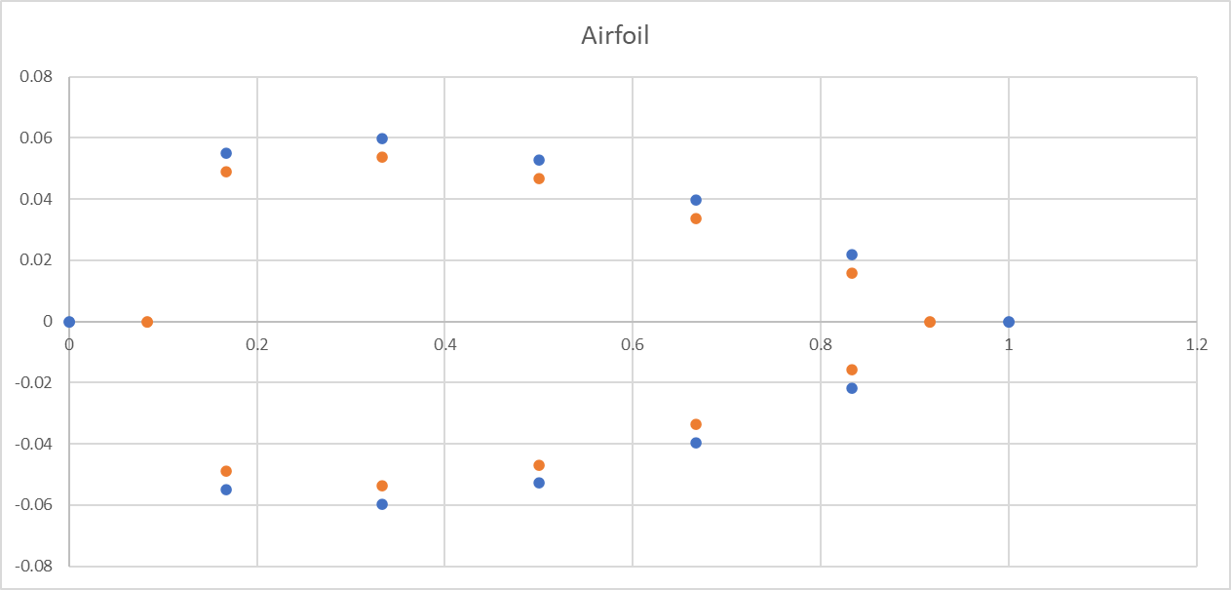
H-Grid Data Structure : Nodes Coordinates

Slide 19
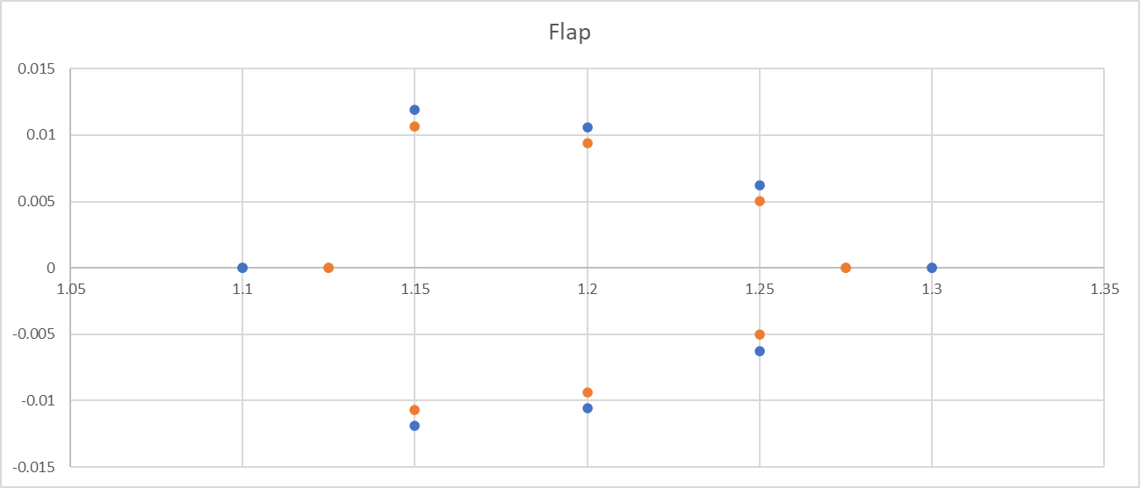
H-Grid Data Structure : Nodes Coordinates

